Slide 1
Chapter 8: Database programming on SQL Server

Slide 2
Objectives
Understand what triggers are for and how to use
Understand what stored-procedure are for and how to use
Understand what cursors are for and how to use
Understand what functions are for and how to use
Understand the difference between T-SQL programming with other programming languages
Understand the useful of trigger, function, stored-procedure (compared with SQL statements)

Slide 3
Contents
T-SQL Programming
Stored-procedure
Functions
Triggers
Cursors

Slide 4
Physical Diagram - FUHCompany

Slide 5
Short introduction to T-SQL programming
Variables
Declare a variable
Example
DECLARE @local_variable [AS] data_type [=initialvalue] , …
data_type: any system-supplied, common language runtime (CLR) user-defined table type. A variable cannot be of text, ntext, or image data type
DECLARE @empName NVARCHAR(20), @empSSN AS DECIMAL, @empSalary DECIMAL=1000

Slide 6
Short introduction to T-SQL programming
Variables (cont)
Assign a value into a variable : using SET or SELECT
Assign a value into a variable using SQL command : SELECT or UPDATE
SET @empName=N’Mai Duy An’
SELECT @empSalary=2000
SELECT @empName=empName, @empSalary=empSalary
FROM tblEmployee
WHERE empName=N'Mai Duy An‘
UPDATE tblEmployee
SET @empName=empName, @empSalary=empSalary
WHERE empName=N'Mai Duy An’

Slide 7
Short introduction to T-SQL programming
Variables (cont)
Display value of a variable : using PRINT or SELECT
Converts an expression from one data type to a different data type : using CAST or CONVERT function
PRINT @empName
SELECT @empSalary
DECLARE @empName NVARCHAR(20), @empSalary DECIMAL
SET @empName=N'Mai Duy An'
SET @empSalary=1000
PRINT @empName + '''s salary is ' + CAST(@empSalary AS VARCHAR)
PRINT @empName + '''s salary is ' + CONVERT(VARCHAR, @empSalary)

Slide 8
Short introduction to T-SQL programming
Flow-control statement
Statement Blocks: Begin…End
Conditional Execution:
IF ... ELSE Statement
CASE ... WHEN
Looping: WHILE Statement
Error handling:
@@ERROR
TRY … CATCH

Slide 9
Short introduction to T-SQL programming
Statement Blocks: BEGIN…END
Groups of statements used with IF, WHILE, and CASE statements must be grouped together using the BEGIN and END statements. Any BEGIN must have a corresponding END in the same batch.
IF ... ELSE Statement
evaluate a Boolean expression and branch execution based on the result
DECLARE @workHours DECIMAL, @bonus DECIMAL
SELECT @workHours=SUM(workHours)
FROM tblWorksOn
WHERE empSSN=30121050027
GROUP BY empSSN
IF (@workHours > 300)
SET @bonus=1000
ELSE
SET @bonus=500
PRINT @bonus

Slide 10
Short introduction to T-SQL programming
CASE ... WHEN Statement
Syntax
Example
CASE input_expression
WHEN when_expression THEN result_expression
[WHEN when_expression THEN result_expression…n]
[ELSE else_result_expression ]
END
DECLARE @depNum DECIMAL, @str NVARCHAR(30)
SET @str=
CASE @depNum
WHEN 1 THEN N'Phòng ban số 1'
WHEN 2 THEN N'Phòng ban số 2'
ELSE N'Mã phòng ban khác 1, 2'
END
PRINT @str

Slide 11
Short introduction to T-SQL programming
We use CASE in statements such as SELECT, UPDATE, DELETE and SET, and in clauses such as SELECT list, IN, WHERE, ORDER BY, and HAVING
DECLARE @womanDayBonus DECIMAL
SELECT @womanDayBonus =
CASE empSex
WHEN 'F' THEN 500
WHEN ‘M' THEN 0
END
FROM tblEmployee
WHERE empSSN=30121050004
PRINT @womanDayBonus

Slide 12
Short introduction to T-SQL programming
WHILE Statement : repeats a statement or block of statements as long as a specified condition remains true
Syntax
Example
WHILE boolean_expression
SQL_statement | block_of_statements
[BREAK]
SQL_statement | block_of_statements
[CONTINUE]
DECLARE @factorial INT, @n INT
SET @n=5
SET @factorial=1
WHILE (@n > 1)
BEGIN
SET @factorial = @factorial*@n
SET @n = @n - 1
END
PRINT @factorial

Slide 13
Short introduction to T-SQL programming
Handling error using @@ERROR function
The @@ERROR system function returns 0 if the last Transact-SQL statement executed successfully; if the statement generated an error, @@ERROR returns the error number
BEGIN TRANSACTION
INSERT INTO tblDepartment(depNum,depName)
VALUES(6, N'Phòng Kế Toán');
INSERT INTO tblDepartment(depNum,depName)
VALUES(6, N'Phòng Kế Toán');
IF @@ERROR<>0
BEGIN
ROLLBACK TRANSACTION
PRINT @@ERROR
END
COMMIT TRANSACTION

Slide 14
Short introduction to T-SQL programming
Handling error using TRY … CATCH
was introduced with SQL Server 2005. Statements to be tested for an error are enclosed in a BEGIN TRY…END TRY block. A CATCH block immediately follows the TRY block, and error-handling logic is stored here
BEGIN TRANSACTION --begin transaction
BEGIN TRY
--oparations
INSERT INTO tblDepartment(depNum,depName)
VALUES(6, N'Phòng Kế Toán');
INSERT INTO tblDepartment(depNum,depName)
VALUES(6, N'Phòng Kế Toán');
COMMIT TRANSACTION --commit the transaction
END TRY
BEGIN CATCH
ROLLBACK TRANSACTION --rollback transaction
PRINT ERROR_NUMBER()
PRINT ERROR_MESSAGE()
END CATCH

Slide 15
Branching Statements
If statement
Ends with keyword END IF
If-statement nested within the else-clause are introduced with the single word ELSEIF
IF <condition> THEN
<statement list>
ELSEIF <condition> THEN
<statement list>
ELSEIF
…
ELSE
<statement list>
END IF;

Slide 16
Queries in T-SQL programming
Several ways that select-from-where queries are used in PSM
Subqueries can be used in conditions, or in general, any place a subquery is legal in SQL
Queries that return a single value can be used as the right sides of assignment statements
A single-row select statement is a legal statement in PSM
We can declare and use a cursor for embedded SQL

Slide 17
Loops in T-SQL programming
The basic loop construct in PSM is
It is possible to break out of the loop
Example
loop1: LOOP
. . .
LEAVE loop1;
. . .
END LOOP;
LOOP
<statement list>
END LOOP;
LEAVE <loop label>;

Slide 18
Other Loop Constructs
WHILE <condition> DO
<statement list>
END WHILE;
REPEAT <statement list>
UNTIL <condition>
END REPEAT;

Slide 19
Exceptions in T-SQL programming
The form of a handler declaration is
The choices for where to go next
CONTINUE
EXIT
UNDO
DECLARE <where to go next> HANDLER FOR
<condition list> <statement list>;

Slide 20
The three – tier Architecture
A very common architecture for large database installation
Three different, interacting functions
Web servers
Application servers
Database servers
The processes can run on the same processor or on a large number of processors

Slide 21
The three – tier Architecture
Database
Database Server
Database Server
Application Server
Application Server
Application Server
Web Server
Web Server
Web Server
Web Server
Internet
Client
Client

Slide 22
The Webserver Tier
The webserver processes manage the interactions with the user
When a user makes contact, a webserver response to the request, and the user becomes a client of this webserver process

Slide 23
The Application Tier
Turning data from the database into a response to the request that it receives from the webserver
One webserver process invoke many application-tier processes, which can be on one or many different machines
The application-tier processes execute the business logic of the organization operating the database

Slide 24
The Database Tier
There can be many processes in the database tier
The processes can be in one or many machines
The database tier executes queries that are requested from the application tier

Slide 25
Advantages of using Stored Procedure
Using stored procedures offer numerous advantages over using SQL statements. These are:
Reuse of Code
Maintainability
Reduced Client/Server Traffic
Precompiled Execution
Improved Security

Slide 26
Stored procedure - Introduction
Persistent, Stored Modules (SQL/PSM)
Help to write procedures in a simple, general-purpose language and to store them in the database
We can use these procedures in SQL queries and other statements to perform computations
Each commercial DBMS offers its own extension of PSM

Slide 27
Creating Stored Procedure under MS SQL Server
Create stored procedure:
CREATE PROCEDURE procedure_name
[ {@parameter1 data_type} [= default] [OUTPUT] ] [ {@parameter2 data_type} [= default] [OUTPUT] ] ...
AS
sql_statement1 sql_statement2
Calling stored procedure
EXEC procedure_name [argument1, argument2, …]

Slide 28
Creating PSM Functions and Procedures
Example 1:
Create stored procedure to list all projects
Create stored procedure to change the project’s name
Create stored function to return the name of project

Slide 29
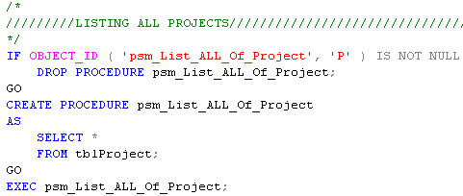
Example

Slide 30
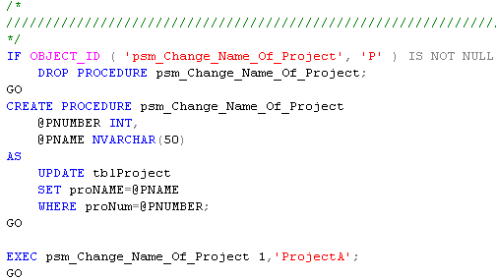
Example

Slide 31
Function in SQL Server
System Defined Function
User Defined Function
Scalar functions
Inline table-valued functions
Multi-statement table-valued functions

Slide 32
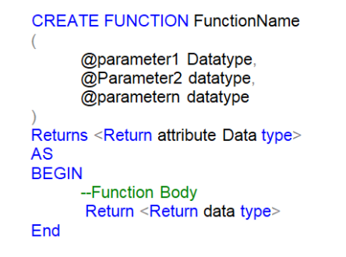

Scalar functions
Calling a Function in SQL Server
//demo

Slide 33
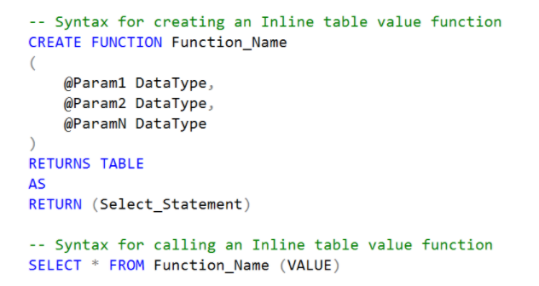
Inline Table-valued Function
//demo

Slide 34
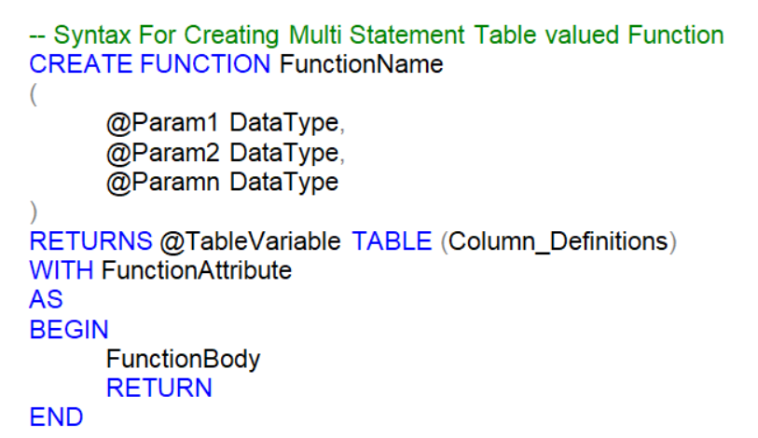
Multi-Statement Table Valued Function
//demo

Slide 35
Triggers
Triggers differ from the other constraints
Triggers are only awakened when certain events occur (INSERT, UPDATE, DELETE)
One awakened, the trigger tests a condition.
If the condition does not hold, trigger do nothing to response to occurred event
If the condition is satisfied, the action associated with trigger is performed by the DBMS

Slide 36
Why uses triggers
Triggers can implement business rules
E.g. creating a new Order when customer checkout a shopping cart (in online ecommerce websites)
Triggers be used to ensure data integrity
E.g. Updating derived attributes when underlying data is changed, or maintaining summary data

Slide 37
Triggers in SQL
Some principle features of triggers
The check of trigger’s condition and the action of the trigger may be executed either on the state of database that exists before the triggering event is itself executed or on the state that exists after the triggering event is executed
The condition and action can refer to both old and/or new values of tuples that were updated in the triggering event
It is possible to define update events that are limited to a particular attribute or set of attributes
Trigger executes either
Once for each modified tuple
Once for all the tuples that are changed in one SQL statement

Slide 38
Triggers in SQL (standard)
CREATE TRIGGER NetWorthTrigger
AFTER UPDATE OF netWorth ON MovieExec
REFERENCING
OLD ROW AS OldTuple,
NEW ROW AS NewTuple
FOR EACH ROW
WHEN (OldTuple.netWorth > NewTuple.netWorth)
UPDATE MovieExec
SET netWorth=OldTuple.netWorth
WHERE cert#=NewTuple.cert#;

Slide 39
The Options for Trigger Design
AFTER/BEFORE
UPDATE/INSERT/DELETE
WHEN (<condition>)
OLD ROW/NEW ROW
BEGIN … END;
FOR EACH ROW/FOR EACH STATEMENT

Slide 40
Implement Trigger with T-SQL

Slide 41
Implement Trigger with T-SQL
Create Trigger on MS SQL Server syntax
Disable a trigger
Enable a trigger
CREATE TRIGGER trigger_name ON TableName
{AFTER {[DELETE] [,] [INSERT] [,] [UPDATE]}
AS
sql_statement 1
sql_statement 2
…
DISABLE TRIGGER <trigger_name> ON <table_name>
ENABLE TRIGGER <trigger_name> ON <table_name>

Slide 42
Implement Trigger with T-SQL Samples
Create the trigger raised after insert on tblEmployee table
Using AFTER INSERT, UPDATE to raise the trigger after INSERT or UPDATE action
IF OBJECT_ID('Tr_Employee_Insert', 'TR') is not null
drop trigger Tr_Employee_Insert
go
CREATE TRIGGER Tr_Employee_Insert ON tblEmployee
AFTER INSERT
AS
RAISERROR('Insert trigger is awakened',16,1)
go

Slide 43
Implement Trigger with T-SQL
Transaction Management in Triggers
A trigger is always part of the transaction that initiates it. That transaction can be explicit (when SQL Server has executed Begin Transaction). It can also be implicit basically (SQL Server treats each Transact-SQL statement as a separate transaction)
CREATE TRIGGER Tr_Employee_Insert ON tblEmployee
AFTER INSERT
AS
RAISERROR('Insert trigger is awakened',16,1)
ROLLBACK TRANSACTION
go
--test
INSERT INTO tblEmployee(empSSN, empName, empSalary, depNum)
VALUES (30121050345, N'Nguyễnn Văn Tý', 10000, 1;
--not found employee whose empSSN is 30121050345
SELECT * FROM tblEmployee WHERE empSSN=30121050345

Slide 44
Implement Trigger with T-SQL
Deleted and Inserted tables
When a trigger is executing, it has access to two memory-resident tables that allow access to the data that was modified: Inserted and Deleted.
These tables are available only within the body of a trigger for read-only access.
The structures of the inserted and deleted tables are the same as the structure of the table on which the trigger is defined
INSERT action
UPDATE action
DELETE action
new data
old data
inserted data
deteted data
Inserted Table
Deleted Table

Slide 45
Implement Trigger with T-SQL
Example: using Deleted and Inserted tables
IF OBJECT_ID('Tr_Employee_Insert', 'TR') is not null
drop trigger Tr_Employee_Insert
go
CREATE TRIGGER Tr_Employee_Insert ON tblEmployee
AFTER INSERT
AS
DECLARE @vEmpSSN DECIMAL, @vEmpName NVARCHAR(50)
SELECT @vEmpSSN=empSSN FROM inserted
SELECT @vEmpName=empName FROM inserted
PRINT 'new tuple:'
PRINT 'empSSN=' + CAST(@vEmpSSN AS nvarchar(11)) + ' empName=' + @vEmpName
go
--test
INSERT INTO tblEmployee(empSSN, empName, empSalary, depNum, supervisorSSN)
VALUES (30121050345, N'Nguyễn Văn Tý', 10000, 1, 30121050037);

Slide 46
Samples
Create the trigger that refuses all under-18-year-old employee’s insertion or update
CREATE TRIGGER Tr_Employee_Under18 ON tblEmployee
AFTER INSERT, UPDATE
AS
DECLARE @empBirthdate DATETIME, @age INT
SELECT @empBirthdate=empBirthdate
FROM inserted
SET @age=YEAR(GETDATE()) - YEAR(@empBirthdate)
IF (@age < 18)
BEGIN
RAISERROR(‘Employee is under 18 years old. We can not sign a contact with him/her.',16,1)
ROLLBACK TRANSACTION
END
go

Slide 47
Samples
Another method: using EXISTS
CREATE TRIGGER Tr_Employee_Under18 ON tblEmployee
AFTER INSERT, UPDATE
AS
IF EXISTS(SELECT *
FROM inserted
WHERE (YEAR(GETDATE())-YEAR(empBirthdate))<18
)
BEGIN
RAISERROR(‘Employee is under 18 years old. We can not sign a contact with him/her.',16,1)
ROLLBACK TRANSACTION
END
go

Slide 48
Using Cursor in MS SQL Server
Declare cursor
DECLARE cursor_name CURSOR FOR SELECT Statement
Open cursor
OPEN cursor_name
Loop and get values of each tuple in cursor with FETCH statement
FETCH NEXT | PRIOR | FIRST | LAST FROM cursor_name INTO @var1, @var2
Using @@FETCH_STATUS to check fetch status. The 0 value mean FETCH statement was successful.
CLOSE cursor_name
DEALLOCATE cursor_name

Slide 49
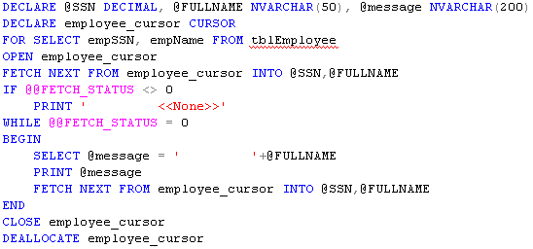
Example

Slide 50
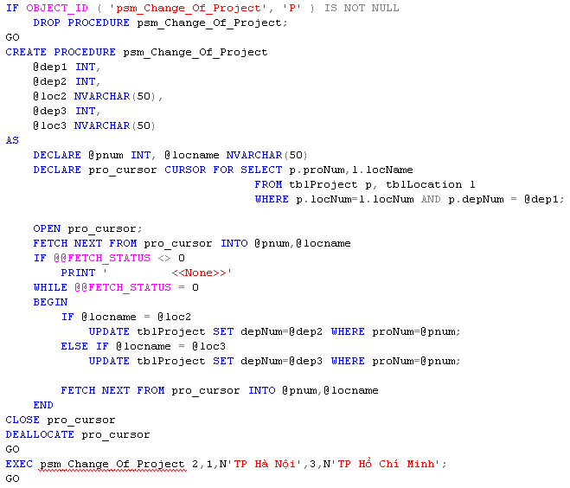
Example

Slide 51
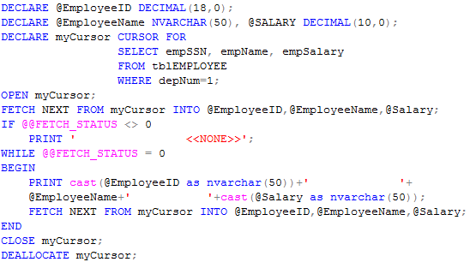
Example

